Slide 1
Microgrids

Slide 2
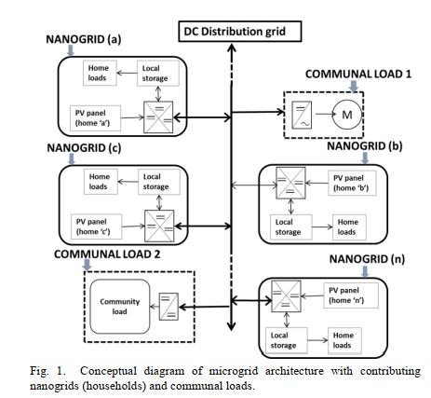
DC Microgrid

Slide 3
NANO GRID
A nanogrid is a basic building block of the microgrid architecture that integrates its resources in a scalable manner into the community. Each house contains a roof-mounted solar panel, a few DC loads and battery storage. The bidirectional flow of power is controlled via power electronic converters referred to as central power processing units (CPPUs). A CPPU contains a microcontroller along with a maximum power point tracking (MPPT)-based DC-DC converter and a bidirectional flyback converter

Slide 4
MICROGRID
A microgrid can be defined as power cluster of distributed generation, load, and energy storage device accumulated together in the vicinity to each other. It gives opportunity to utilize renewable energy sources for green and clean environment.

Slide 5
DC MICROGRID
A microgrid can be defined as power cluster of distributed generation, load, and energy storage device accumulated together in the vicinity to each other. ... The DC terminals are connected to electronic loads, electric vehicles, and batteries which form a Direct Current Microgrid.

Slide 6
AC MICROGRID
AC microgrid. An AC microgrid connects to the distribution network via an AC bus, and the AC bus controls the microgrid's connection to and disconnection from the distribution network through the circuit breaker at the PCC.

Slide 7
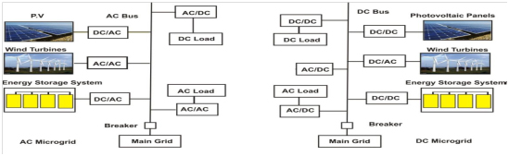
Ac and dc microgrid

Slide 8
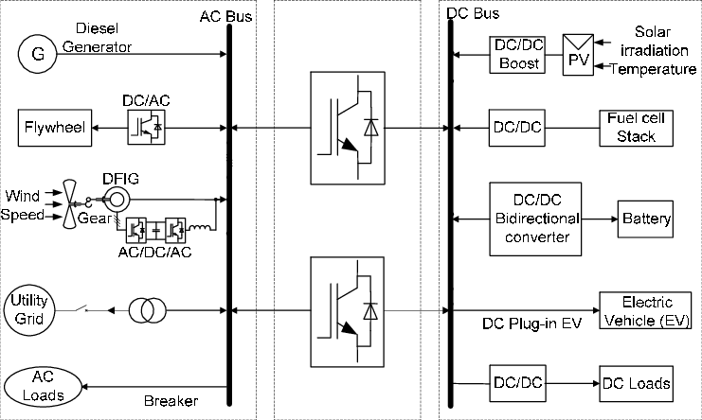
Ac/dc microgrid

Slide 9
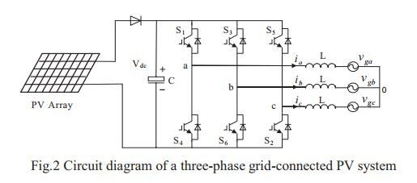
Integration system (CLO2)

Slide 10
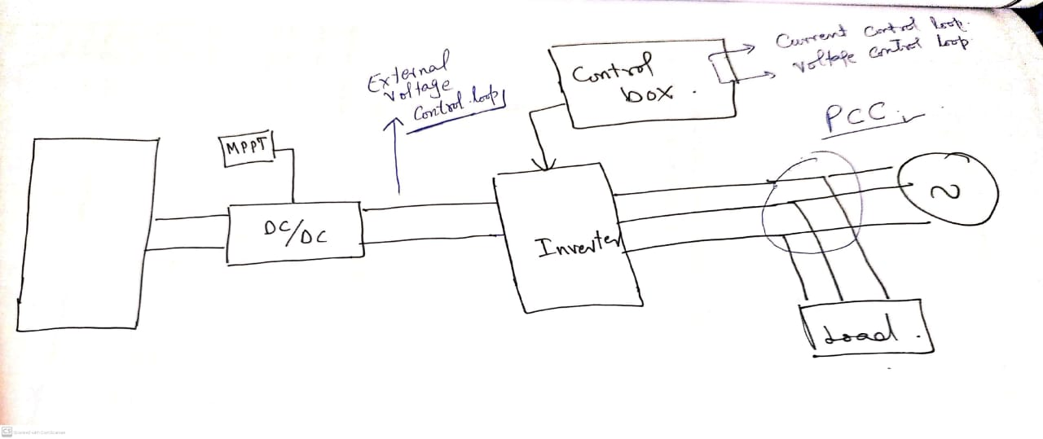

Slide 11
the block diagram of the current control system. In the decoupled d-axis and q-axis current control loops, two conventional PI controllers are employed to eliminate current errors. The grid voltage vector is used in a feed-forward loop to compensate for the grid harmonics.
The outputs of PI controllers are inductor filter voltage references vLd* and vLq* that are superimposed by vgd and vgq to generate the inverter output voltage references vd* and vq* for SVPWM, as proposed by the Authors. The current references id* and iq* are provided by the output of PV Array.

Slide 12
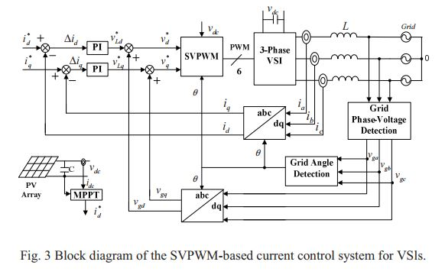
Current control loop

Slide 13
Grid Tie Mode
ABC to DQ0 Clarke &Park
Transformation
Vabc
PLL
Vdq
θ
Id
Vd
Idq
−
Vabc
Iabc
Idref
PI
∑
Vdcref
DQ0 to ABC
SVPWM
Iq
_
Reference current
ωl
Vdref
Vdc
Id
ωl
Vqref
Vabc
+
PI
∑
Iqref
−
θ
Iq
Vq

Slide 14

GRID TIE MODE
Current control mode of operation
P/Q control mode
Unity power factor
Power flow from microgrids towards utility grid.
$V_{dref}=Vd− ωLI_{q}+ \frac{Ldi_{d}}{dt}$
$V_{qref}=Vq+ ωLI_{d}+ \frac{Ldi_{q}}{dt}$

Slide 15
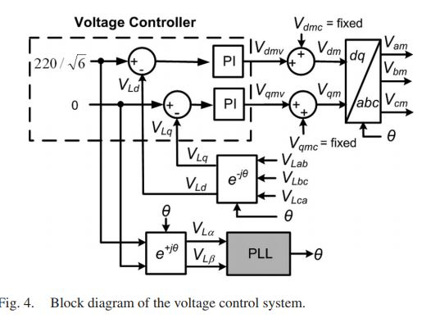
Voltage control loop

Slide 16


Island Mode
θref
ABC to dq0
Vdq$∗$
Vd*
Idq*
−
Id*
Vabc
Iabc
Vd
Idref
+
+
PI
PI
∑
DQ0
To
ABC
SVPWM
Iq
−
Vdc
ωl
Reference voltages
ωl
Vdcref
Id
+
PI
PI
$$∑$$
Vq
+
−
Iqref
+
Vq*
Iq*

Slide 17
Effective control strategies for reliable photovoltaic (PV) grid-connected systems are needed to efficiently use solar energy, an abundant and clean renewable energy source
Space vector pulse width modulation (SVPWM) has been widely applied in the current control of three-phase voltage source inverters (VSIs).
The control strategy combines a constant voltage tracking method for the variable photovoltaic power with SVPWM-based proptional-intergral (PI) current controller in a single stage three-phase PV grid-connected system.

Slide 18
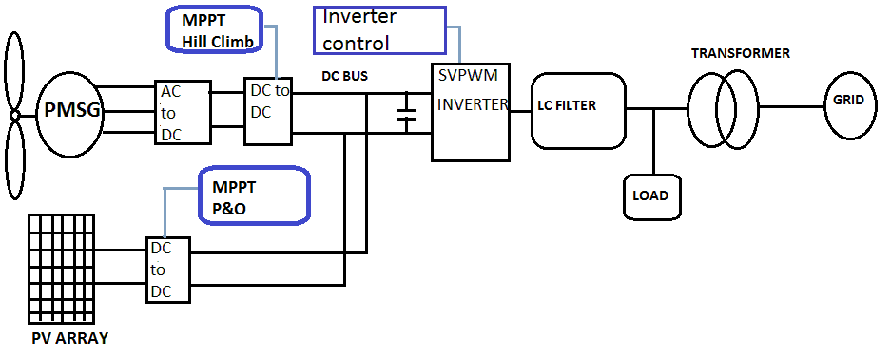
Hybrid System

Slide 19
Results
Case 1.
Grid tie Mode operation
PV radiation varies from 3 to 5 seconds
Constant load profile

Slide 20
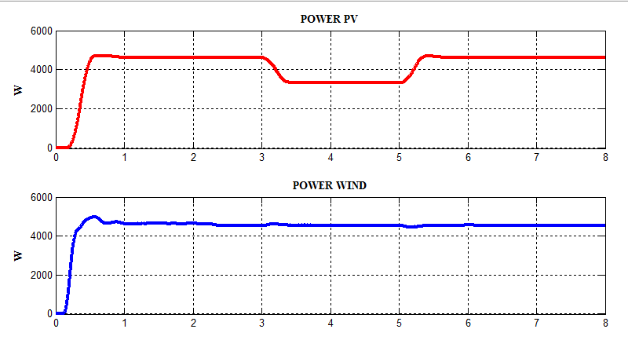
PV and PMSG Power

Slide 21
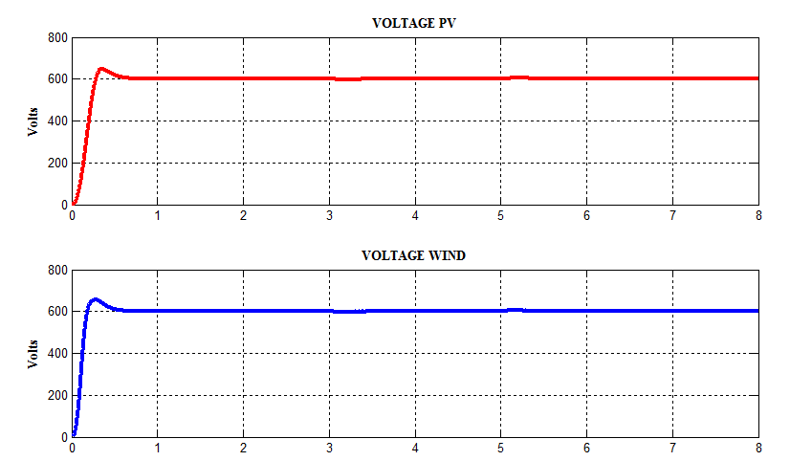
DC Link Voltage

Slide 22
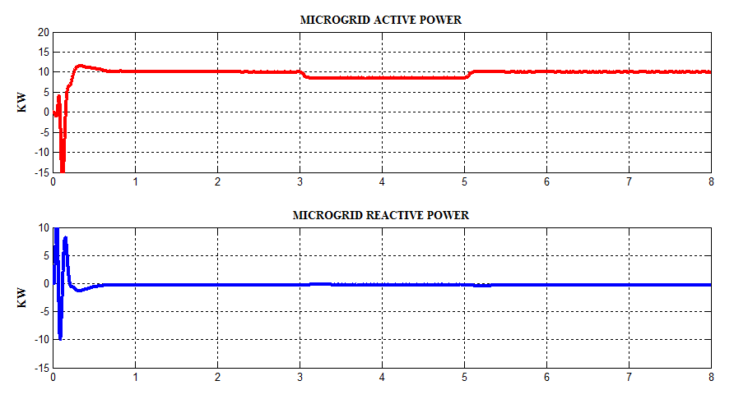
Microgrid active and reactive power

Slide 23
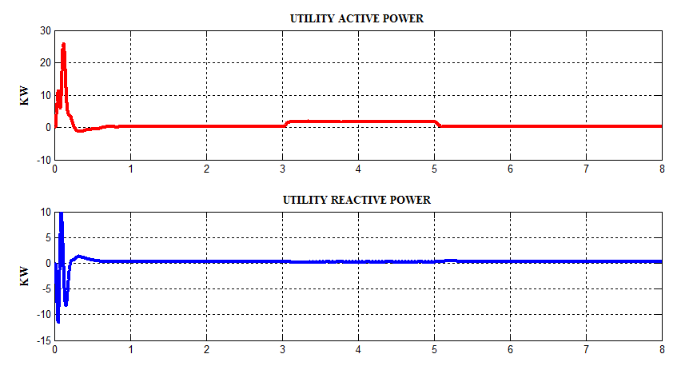
Utility grid active and reactive power

Slide 24
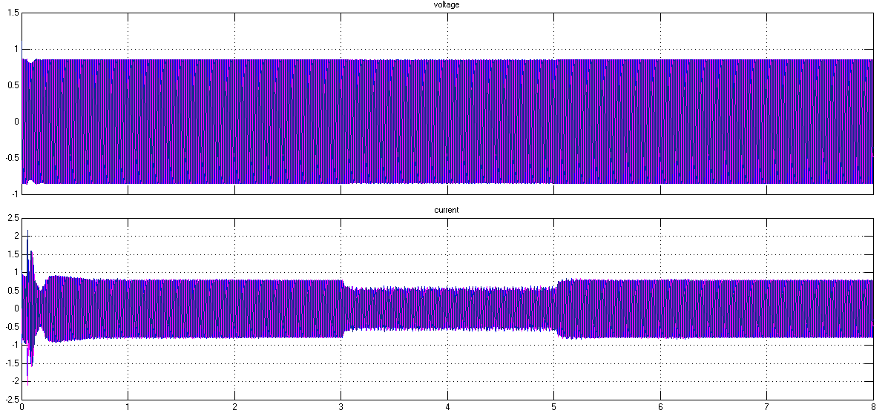
Voltage and current of microgrid

Slide 25
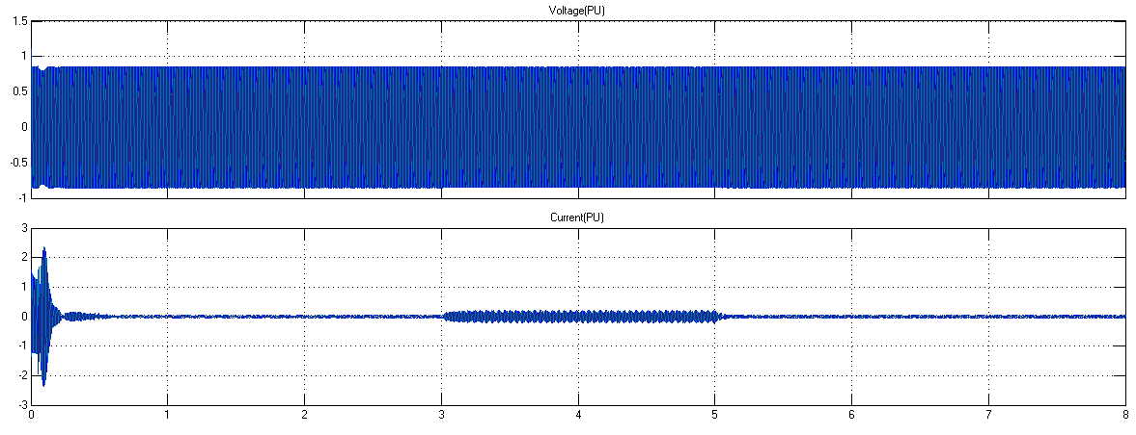
Voltage and current of utility grid

Slide 26
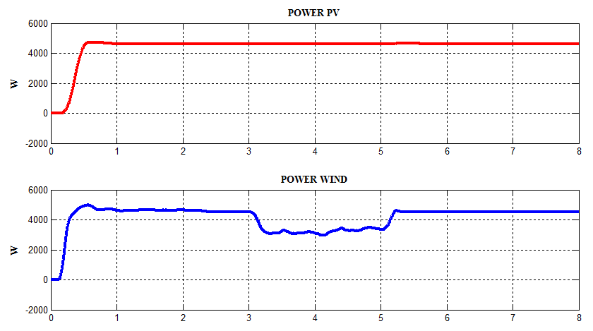
PMSG and PV Power case 2

Slide 27
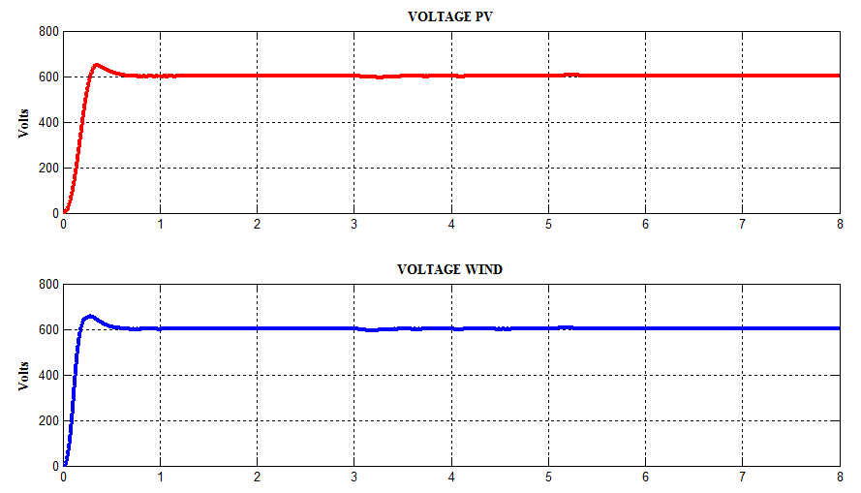
DC Link Voltage

Slide 28
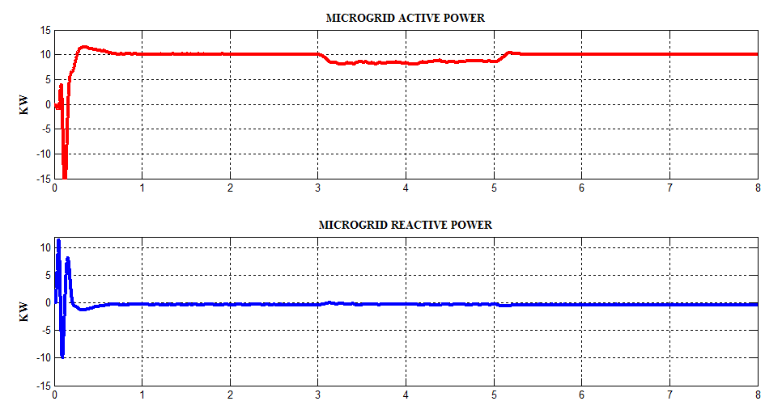
Active and Reactive power of microgrid

Slide 29
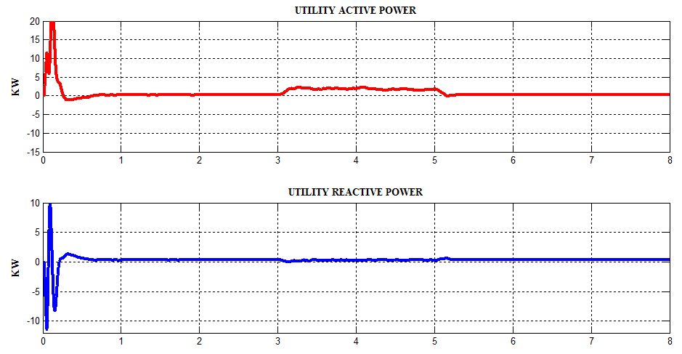
Active and reactive power of utility grid

Slide 30
Case 3
Grid tie mode operation
Load decrease from 10 Kw to 5 Kw
5 Kw is injected to utility grid

Slide 31
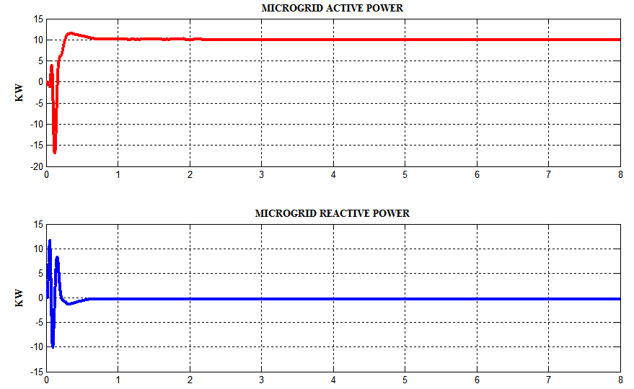
Active and Reactive power of microgrid

Slide 32
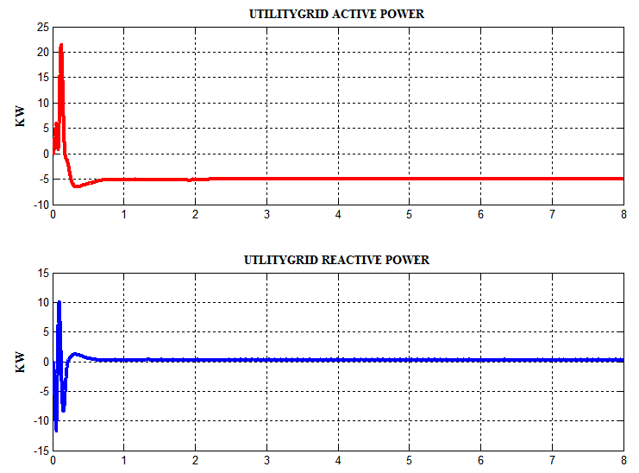
Active and Reactive power of utility grid

Slide 33
Case 4
Grid tie mode to island mode
Constant power generation
Constant load profile

Slide 34
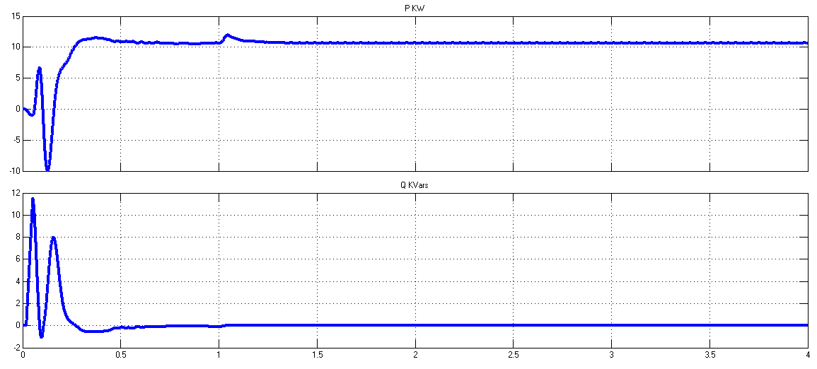
Active and Reactive power of microgrid

Slide 35
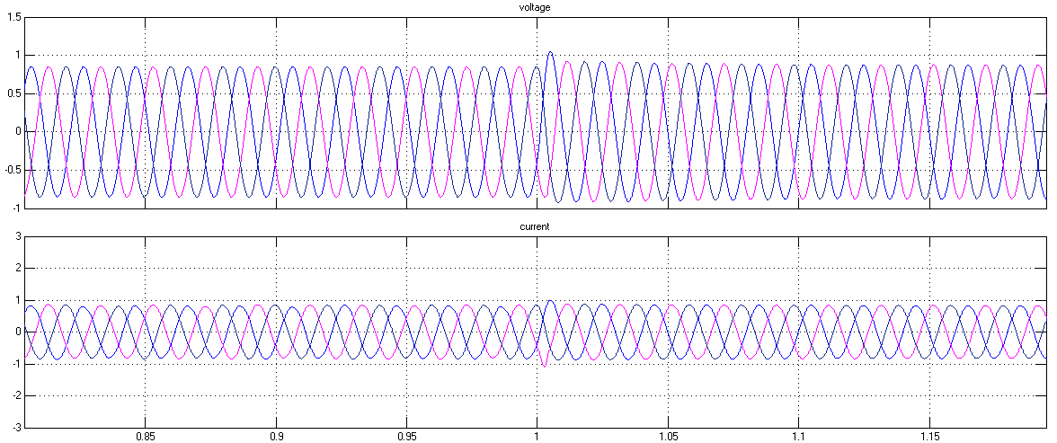
Voltage and current of microgrid in zoom

